Slide 1



Surgical Coordinator Guide
Enhanced Recovery After Surgery (ERAS®)

Slide 2
Objectives
1. Outline the components and basic principles of the ERAS protocol.
2. Review the benefits of using an ERAS protocol and the science behind ERAS protocols.
3. Define the role of the surgical coordinator/surgical educator and help guide preparation of patients for surgery.

Slide 3


What is ERAS®?
A care pathway designed to achieve faster recovery for patients undergoing surgery.
Re-examines traditional practices, replacing them with evidence-based practices when necessary.
Covers all areas of a patient's journey through the surgical process.
Enhanced
Recovery
After
Surgery

Slide 4
Benefits of ERAS®
Research has consistently shown that adoption of an enhanced recovery program leads to significant improvements which include:
  Increased patient satisfaction
  Faster patient recovery
    Decreased post-op pain and narcotic use
    Improved post-operative mobility
    Quicker return of bowel function
  Shortened hospital stays
  Decreased surgical complications and hospital readmission rates
  Reduced cost of care (as high as $4400 or 10% per patient)

Slide 5
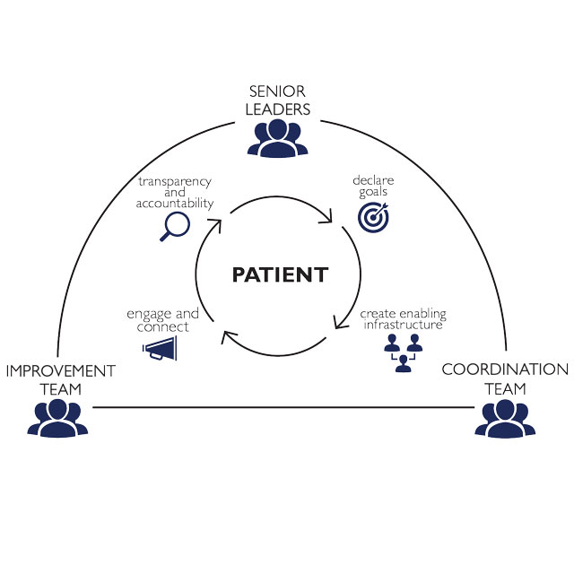
ERAS®: Compliance Monitoring
Is a quality metric
Tracked in a number of ways
Requires a team effort
Non-compliance or deviation from protocol is associated with adverse postop outcomes and increase in length of hospital stay
Notes:
noncompliance or deviation from the ERAS protocol has been shown in itself to worsen postoperative outcomes and result in increased LOS [13& ,46].

Slide 6
ERAS Procedure Tracking at GBMC
Total Hip
Total Knee
Spine
Abdominal Colorectal
Hysterectomies
Refer to service line ERAS protocols

Slide 7
Surgical Coordinator/Office Educator Role
The ERAS® protocol is centered on patient education that begins well BEFORE the patient enters the OR
  requires a team approach to succeed
  You are a key member of the Team!
As the office educator, you will be reviewing the GBMC ERAS patient education packet with the patient prior to surgery

Slide 8
Successful ERAS® Implementation: Background
To properly educate patients, it is important you understand ERAS interventions and why they are so important.
The key factors that keep patients in the hospital after surgery include:
Pain
Gastrointestinal Dysfunction
Lack of ability to get out of bed

Slide 9
Basic Components
Pre-op
Intra-op
Post-op
Notes:
ERAS programs involve multidisciplinary efforts and rely on patients’ participation in their own care. Patients and family should be given clear instructions on how to prepare for surgery and recovery, postop activty, diet, and expectations about pain and and expected recovery. Discuss things like constipation, vaginal bleeding, low appetite, and fatigue. Not only does this decrease the number of postop phone calls, it decreases patient anxiety. In general just knowing how to contact on call doctor significantly decreases anxiety. Discuss discharge based on specific milestones or criteria rather than time based. Repitition repition - give verbal instructions, written instrucitons
Mitigate modifiable risks: stop smoking, correct anemia,
contrast with traditional surgical practices such as preoperative fasting, bowel preparations, abdominal drain use, prolonged use of catheters with bedrest, and slow advancement of diet based on passage of flatus or findings of bowel sounds on exam.
Nutritional status assessment, carbohydrate loading, and protein-rich immuno-nutrition for the high-risk patients are incorporated into preoperative strategies as part of a concept known as ‘prehabilitation’ [12]. Also included in prehabilitation recommendations is increased activity and physiotherapy prior to surgery to optimize functional capacity and reserve
Intraoperative interventions include use of multimodal preoperative analgesia, shorter-acting anesthetics, and regional anesthesia when feasible [3]. Analgesia is often preemptive with administration of acetaminophen, nonsteroidal anti-inflammatory drugs (NSAIDs), gabapentinoids, and/or COX-2 inhibitors in the preoperative holding area
Goal-directed fluid administration is used to maintain euvolemia and decrease electrolyte imbalance. Patients avoid traditional fasting and may safely consume solids and clear liquids up to 6 and 2 h, respectively, before surgery
proactive management of bowel function is continued with early feeding and ambulation, discontinuation of intravenous fluids and lines, and liberal use of laxatives or bowel stimulants including chewing gum

Slide 10
Basic Components
Patient education and counseling
Optimization of comorbidities (ex) OSA – CPAP use, smoking cessation)
Increased activity, “Pre-Hab”
Breathing exercises
Nutritional support
Preoperative medication: pain, nausea/vomiting prevention
Infection prevention: Chlorohexidine
Pre-op
Notes:
ERAS programs involve multidisciplinary efforts and rely on patients’ participation in their own care. Patients and family should be given clear instructions on how to prepare for surgery and recovery, postop activty, diet, and expectations about pain and and expected recovery. Discuss things like constipation, vaginal bleeding, low appetite, and fatigue. Not only does this decrease the number of postop phone calls, it decreases patient anxiety. In general just knowing how to contact on call doctor significantly decreases anxiety. Discuss discharge based on specific milestones or criteria rather than time based. Repitition repition - give verbal instructions, written instrucitons
Mitigate modifiable risks: stop smoking, correct anemia,
contrast with traditional surgical practices such as preoperative fasting, bowel preparations, abdominal drain use, prolonged use of catheters with bedrest, and slow advancement of diet based on passage of flatus or findings of bowel sounds on exam.
Nutritional status assessment, carbohydrate loading, and protein-rich immuno-nutrition for the high-risk patients are incorporated into preoperative strategies as part of a concept known as ‘prehabilitation’ [12]. Also included in prehabilitation recommendations is increased activity and physiotherapy prior to surgery to optimize functional capacity and reserve
Intraoperative interventions include use of multimodal preoperative analgesia, shorter-acting anesthetics, and regional anesthesia when feasible [3]. Analgesia is often preemptive with administration of acetaminophen, nonsteroidal anti-inflammatory drugs (NSAIDs), gabapentinoids, and/or COX-2 inhibitors in the preoperative holding area
Goal-directed fluid administration is used to maintain euvolemia and decrease electrolyte imbalance. Patients avoid traditional fasting and may safely consume solids and clear liquids up to 6 and 2 h, respectively, before surgery
proactive management of bowel function is continued with early feeding and ambulation, discontinuation of intravenous fluids and lines, and liberal use of laxatives or bowel stimulants including chewing gum

Slide 11
Basic Components
Minimally invasive route of surgery when possible
Maintenance of euvolemia
Hypothermia prevention
Normoglycemia
Multimodal narcotic sparing analgesia/anesthesia
Minimize catheters/drains
Intra-op
Notes:
ERAS programs involve multidisciplinary efforts and rely on patients’ participation in their own care. Patients and family should be given clear instructions on how to prepare for surgery and recovery, postop activty, diet, and expectations about pain and and expected recovery. Discuss things like constipation, vaginal bleeding, low appetite, and fatigue. Not only does this decrease the number of postop phone calls, it decreases patient anxiety. In general just knowing how to contact on call doctor significantly decreases anxiety. Discuss discharge based on specific milestones or criteria rather than time based. Repitition repition - give verbal instructions, written instrucitons
Mitigate modifiable risks: stop smoking, correct anemia,
contrast with traditional surgical practices such as preoperative fasting, bowel preparations, abdominal drain use, prolonged use of catheters with bedrest, and slow advancement of diet based on passage of flatus or findings of bowel sounds on exam.
Nutritional status assessment, carbohydrate loading, and protein-rich immuno-nutrition for the high-risk patients are incorporated into preoperative strategies as part of a concept known as ‘prehabilitation’ [12]. Also included in prehabilitation recommendations is increased activity and physiotherapy prior to surgery to optimize functional capacity and reserve
Intraoperative interventions include use of multimodal preoperative analgesia, shorter-acting anesthetics, and regional anesthesia when feasible [3]. Analgesia is often preemptive with administration of acetaminophen, nonsteroidal anti-inflammatory drugs (NSAIDs), gabapentinoids, and/or COX-2 inhibitors in the preoperative holding area
Goal-directed fluid administration is used to maintain euvolemia and decrease electrolyte imbalance. Patients avoid traditional fasting and may safely consume solids and clear liquids up to 6 and 2 h, respectively, before surgery
proactive management of bowel function is continued with early feeding and ambulation, discontinuation of intravenous fluids and lines, and liberal use of laxatives or bowel stimulants including chewing gum

Slide 12
Basic Components
Multimodal Pain control
Anti-emetics
Increased activity
Early feeding
Proactive Bowel regimen
Gum chewing
Patient education and counseling: setting expectations
Post-op
Notes:
ERAS programs involve multidisciplinary efforts and rely on patients’ participation in their own care. Patients and family should be given clear instructions on how to prepare for surgery and recovery, postop activty, diet, and expectations about pain and and expected recovery. Discuss things like constipation, vaginal bleeding, low appetite, and fatigue. Not only does this decrease the number of postop phone calls, it decreases patient anxiety. In general just knowing how to contact on call doctor significantly decreases anxiety. Discuss discharge based on specific milestones or criteria rather than time based. Repitition repition - give verbal instructions, written instrucitons
Mitigate modifiable risks: stop smoking, correct anemia,
contrast with traditional surgical practices such as preoperative fasting, bowel preparations, abdominal drain use, prolonged use of catheters with bedrest, and slow advancement of diet based on passage of flatus or findings of bowel sounds on exam.
Nutritional status assessment, carbohydrate loading, and protein-rich immuno-nutrition for the high-risk patients are incorporated into preoperative strategies as part of a concept known as ‘prehabilitation’ [12]. Also included in prehabilitation recommendations is increased activity and physiotherapy prior to surgery to optimize functional capacity and reserve
Intraoperative interventions include use of multimodal preoperative analgesia, shorter-acting anesthetics, and regional anesthesia when feasible [3]. Analgesia is often preemptive with administration of acetaminophen, nonsteroidal anti-inflammatory drugs (NSAIDs), gabapentinoids, and/or COX-2 inhibitors in the preoperative holding area
Goal-directed fluid administration is used to maintain euvolemia and decrease electrolyte imbalance. Patients avoid traditional fasting and may safely consume solids and clear liquids up to 6 and 2 h, respectively, before surgery
proactive management of bowel function is continued with early feeding and ambulation, discontinuation of intravenous fluids and lines, and liberal use of laxatives or bowel stimulants including chewing gum

Slide 13


ERAS® Key Components
C.H.E.E.R.S
Carbohydrate loaded (not hungry)
Hydrated (not thirsty)
Euvolemic (right amount of fluid)
Eunatraemic (right amount of salt)
Ready to
Start to
DR.EA.M.S
DRinking
EAting
Mobilizing
Sleeping
Notes:
Inappropriate fluid intake in the perioperative period can cause harm, delayed recovery and complications for patients. CHEERS is an acronym is an that represents the goals that fluid management should seek to meet being mindful of the importance of giving the right amount of fluid…. not too much….not too little/ Patients should be encouraged to eat and drink right up to the limits defined for them preoperatively. This will vary based on a patient's health history. Use of clear carbohydrate-based drinks before surgery results in patients being in a metabolically fed state that reduces postoperative insulin resistance, and restores an earlier return to normal gut function.
DREAMS, is an acronym representing actions that lead to improved surgical outcomes. A good enhanced recovery program will result in improvement in each domain.

Slide 14


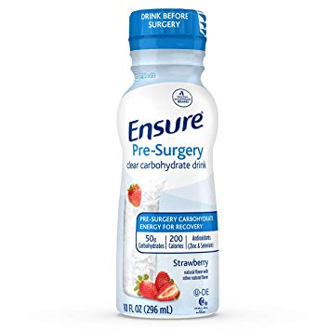
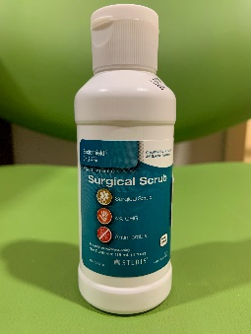

Key Interventions
Our ERAS program has 5 main interventions which are important for the patient to do at home before coming to the hospital for their procedure.
1) Practice Deep Breathing Exercises
2) Shower with Hibiclens solution
3) Drink the Ensure Pre-Surgery
4) Follow instructions for medications in preparation for your surgery
5) Complete bowel preparation***
*** Only for patients expected to have surgery involving bowel as determined by the surgeon

Slide 15


Deep Breathing Exercises
Instruct the Patient to Practice Deep Breathing Exercises leading up to their surgery.
Performing deep breathing exercises will decrease the likelihood the patient will develop respiratory complications after surgery.
It’s like a work-out for their lungs!
Instruct the patient to:
1) Sit upright.
2) Take a few slow breaths, then take a slow, deep breath in through your nose.
3) Hold your breath for 2-5 seconds.
4) Gently and Slowly breathe out through your mouth making an “O” shape.
5) Repeat 10-15 times.
*Do this 10 times/day

Slide 16

Showering with Hibiclens Solution
Hibiclens is a powerful disinfectant that will help make sure the patient’s skin is free of germs.
Showering with Hibiclens solution will reduce the patient's risk of developing a surgical site infection.

Slide 17

Showering with Hibiclens Solution
Using the following directions, to instruct the patient to:
Shower the night before and the morning of surgery with Hibiclens.
1) Wash your hair with your normal shampoo and rinse it well. Rinse any leftover shampoo from your skin.
2) Wash your face and genital (private) areas with regular soap and water only.
3) Rinse your body very well with warm water.
4) Use a CLEAN washcloth to apply Hibiclens to each part of your body listed below:
a. Neck and chest
b. Legs and feet
c. Hands and arms
d. Back and rear
e. Stomach
5) Leave the Hibiclens on your skin for five minutes.
6) Rinse very well with warm water.
7) Pat yourself dry with a clean towel.
8) Put on clean clothes.
Patients with CHG/Hibiclens allergy can use Theraworx or antibacterial soap.

Slide 18
Ensure Pre-Surgery Carbohydrate Drink
Purpose:
  Helps keep patient hydrated.
  Keeps patient blood sugar levels stable so the body does not try to break down muscle or fat for energy.
  Helps body store energy for recovery.
Instruct the Patient:
Diabetic, BMI>39, Gastroparesis, GERD, pregnant, GLP-Agonists | All other Patients
One bottle of Ensure Drink before bed the night before surgery. | Two Bottles of Ensure Drink 1st bottle before bed night before surgery. Drink 2nd bottle on their way to hospital morning of surgery.
****Other options: Gatorade - 20 oz = 35 g Carb, Boost Breeze (8 oz = 54 g Carb), Clear Fast (12 oz - 50 g carb)

Slide 19

Exercise
Surgery is ultimately like running a marathon.
The term “Prehabilitation” refers to working out before surgery.
Instruct the patient to Increase their exercise!
Even adding in just 10 minutes of walking 3 times a day will help increase their stamina!

Slide 20

General Medication Instructions
Please refer to the following regarding medication instructions for patients scheduled for surgery at GBMC
perioperative-medications-updates-2023.pdf (gbmc.org)

Slide 21
Questions???
Rachel Hellmann MSN, RN, CNOR
Perioperative and Procedural Clinical Program Nurse Manager (ERAS)
Greater Baltimore Medical Center
6701 N. Charles Street, Towson, MD
rhellmann@gbmc.org

